Slide 1
Impact Based Forecasting and Risk Based Warnings
Mark Bevan and Chris Tubbs
Session 3 - 01 November 2016

Slide 2
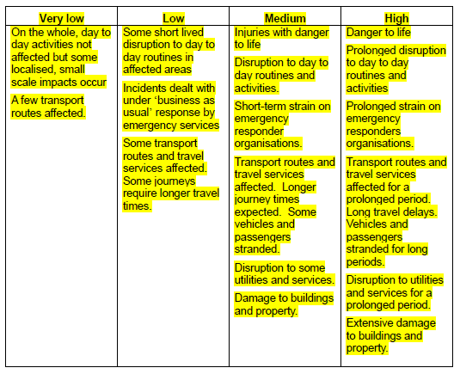
All weather types

Slide 3
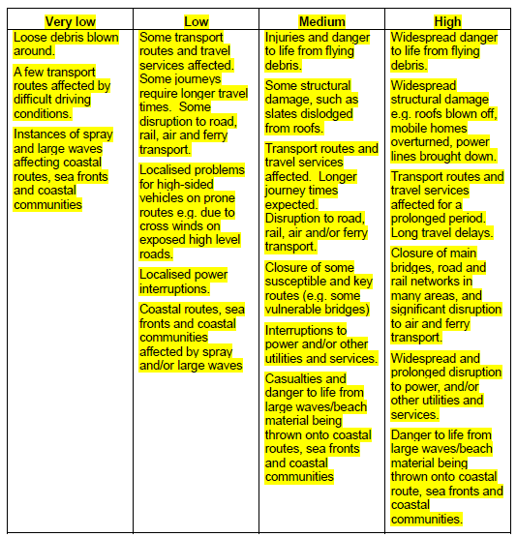
Wind

Slide 4
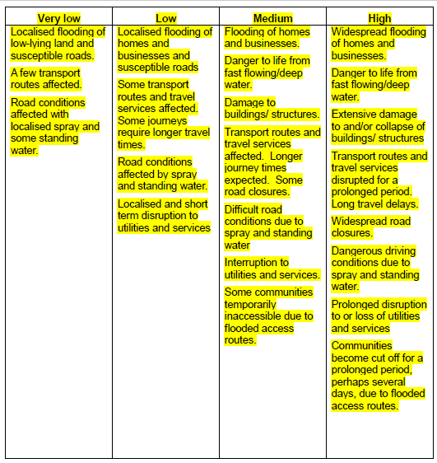
Rain

Slide 5
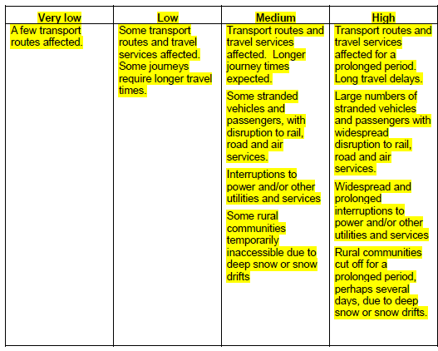
Snow

Slide 6
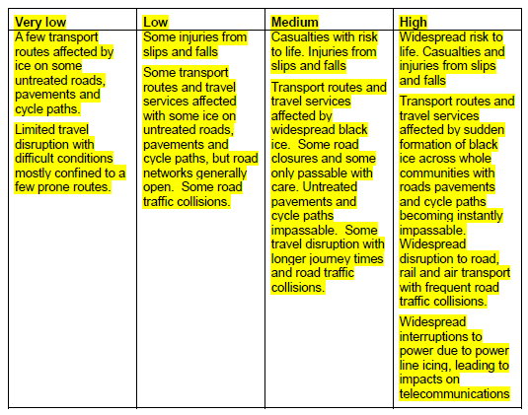
Ice

Slide 7
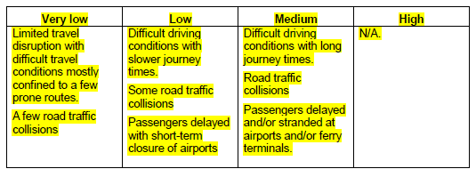
Fog

